Slide 1

A Summer at Bose
With Lexi Ryan

Slide 2
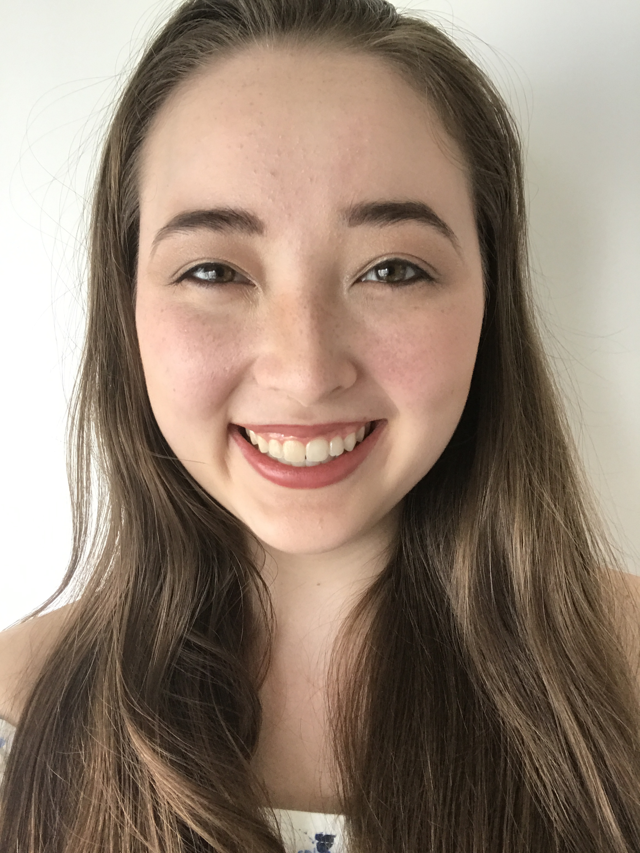
Who Am I?
Lexi
A Southborough native who admittedly uses a GPS to get here
A rising junior at Northwestern University studying Computer Science and Linguistics
Notes:
Been here since July 1 with the Text and Language team

Slide 3
Tai ChI
A review
TEXT AND LANGUAGE TEAM

Slide 4
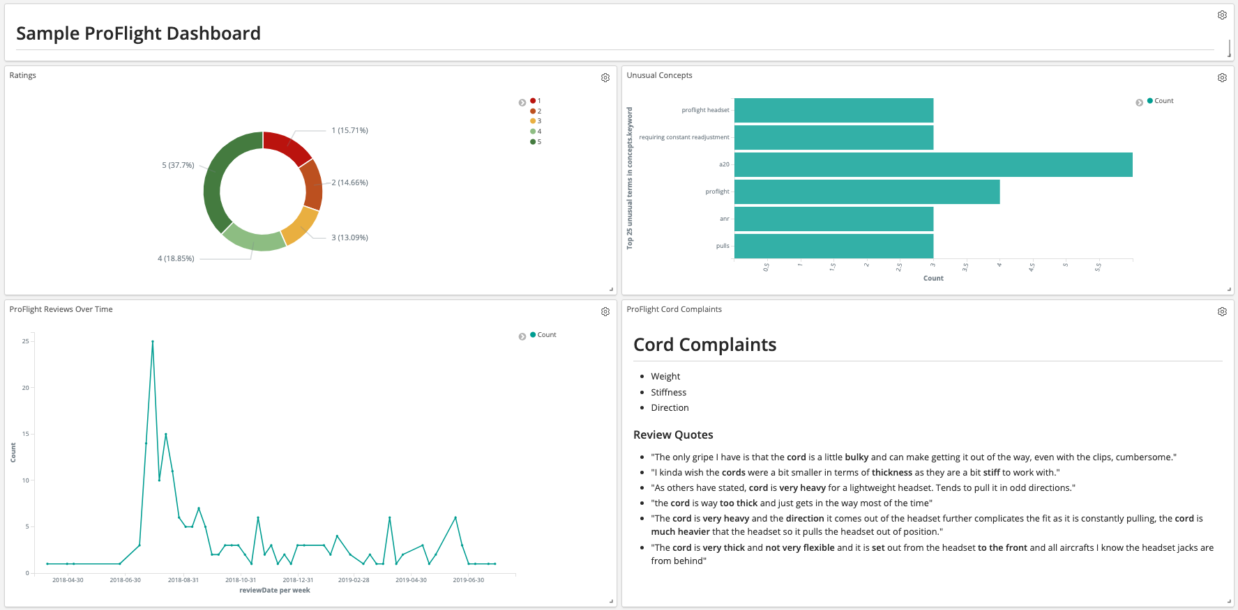
Text and Language Augmentation
Notes:
Take in unstructured text data from various sources: reviews, survey responses
Run our NLP services on it to augment the data – e.g. categorization, named entity recognition
Make it accessible for users to explore, visualize, and analyze
When I had difficulty navigating Kibana at first, due to its poor built-in user interface (which is being worked on right now!), I created a handy guide, which I have since used while interfacing directly with stakeholders to explain how to use our service. The guide will be available from the new landing page.

Slide 5
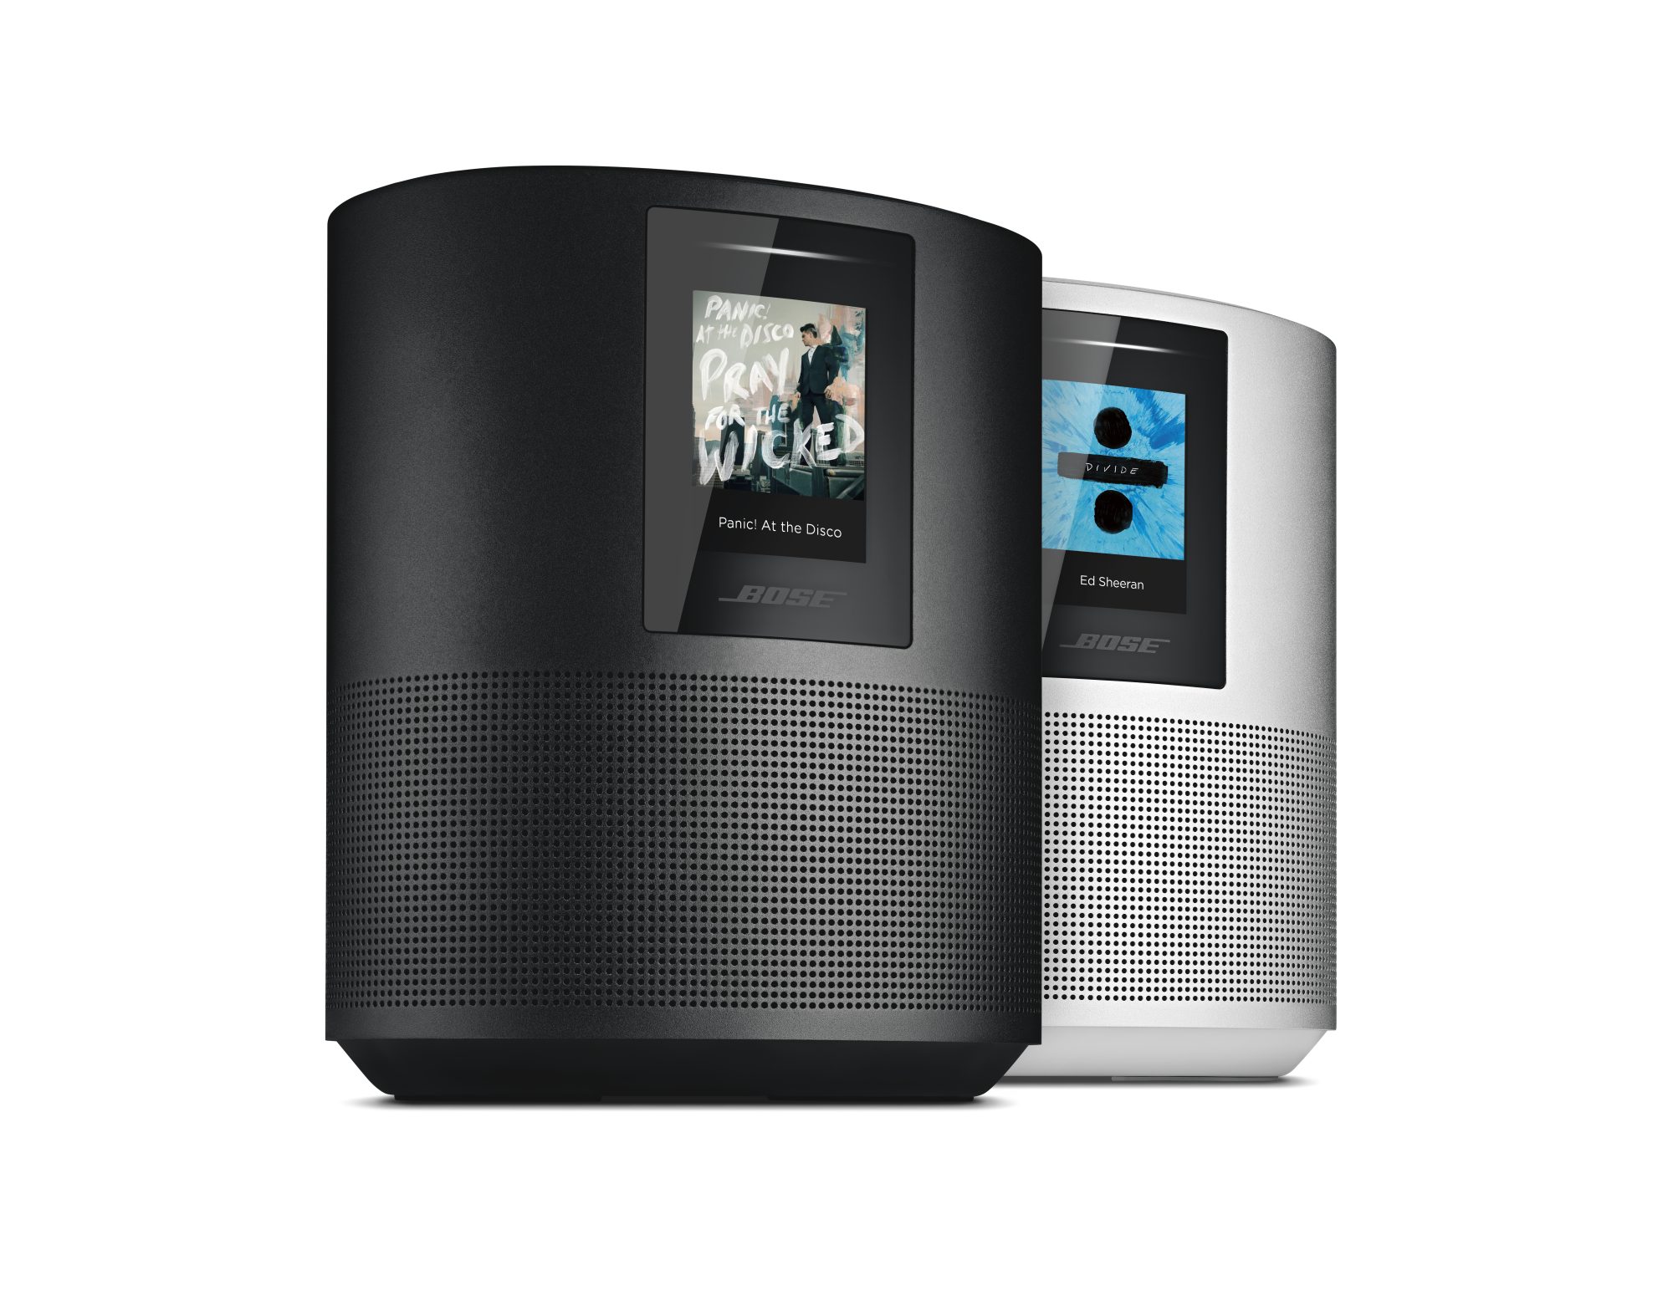
Wishlist Service
Source:
Notes:
Augment data by identifying items that customers want to see.

Slide 6
Wishlist Goal
Notes:
Concept presented in 2018 by Russel and Ravi. Done entirely manually, which was labor-intensive. (Read 1000+ excerpts just based on “I wish”, took ~a week).
"I wish..." from blurb of text

Slide 7
Wishlist Process
Get Data
Find Wishlist Data
Extract Sentences
Extract Concepts
Aggregate Concepts
Display Fields
Notes:
This is an outline of the process. I will get into more details on the steps later on.
Use reviews as example – data I am most familiar with.
Get data step already handled in pipeline – scraped from web and purchased from 3rd party sources.

Slide 8
Wishlist Process
Review 1:
“I love the SoundSport Free!”
Review 2:
“This was the biggest waste of money.”
Get Data
Find Wishlist Data
Extract Sentences
Extract Concepts
Aggregate Concepts
Display Fields
Review 3:
“It has great sound quality. I wish it came in pink.”
“I wish it came in pink.”
“It has great sound quality. I wish it came in pink.”
“It has great sound quality. I wish it came in pink.”
Review 4:
“It would be great if you had green too. Too pricey.”
“It would be great if you had green too.”
“It would be great if you had green too. Too pricey.”
“It would be great if you had green too. Too pricey.”
Review 5:
“Could you speak more in a voice? I do not know how to use, so thank you.”
Notes:
Use reviews as example – data I am most familiar with.
Get data step already handled in pipeline – scraped from web and purchased from 3rd party sources.

Slide 9
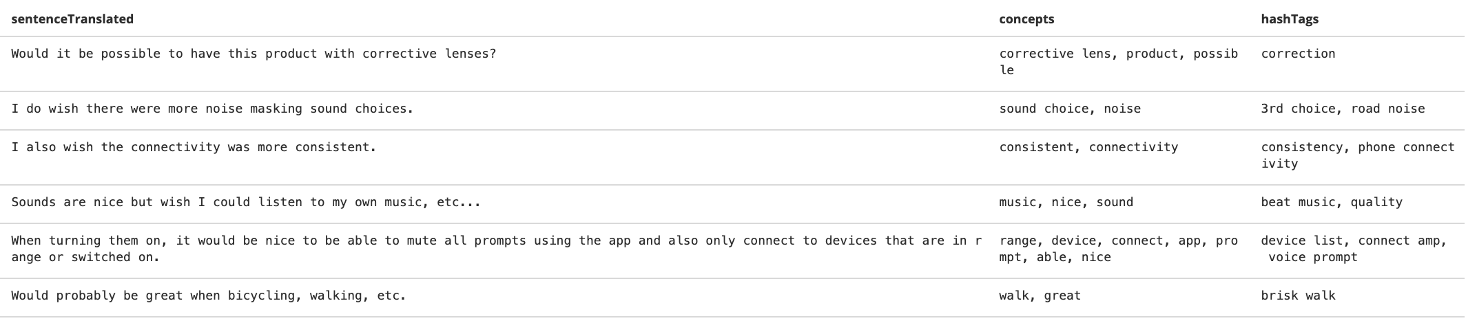
Wishlist Process
“I wish it came in pink.”
pink
colors
“I wish it came in pink.”
pink
“I wish it came in pink.”
“I wish it came in pink.”
“It would be great if you had green too.”
green
colors
“It would be great if you had green too.”
green
“It would be great if you had green too.”
“It would be great if you had green too.”
Notes:
From here, you can make all sorts of useful charts and visuals

Slide 10
Get Data
Find Wishlist Data
Extract Sentences
Extract Concepts
Aggregate Concepts
Display Fields
Notes:
Worked on each step of the pipeline except the first one. Today will focus on these 2 stages for time’s sake, but can field questions about the other stages/my contributions to them.

Slide 11
Finding data with wishlist items
Notes:
How do we discover which data out of the corpus are talking about wishlist items?
Eg. Which reviews are talking about wishlist items.

Slide 12
“I love the SoundSport Free!”
“This was the biggest waste of money.”
“It has great sound quality. I wish it came in pink.”
“It has great sound quality. I wish it came in pink.”
“It would be great if you had green too. Too pricey.”
“It would be great if you had green too. Too pricey.”
“Could you speak more in a voice? I do not know how to use, so thank you.”

Slide 13
Find Wishlist Data
How do we discover which data are talking about wishlist items?
Create a set of linguistic rules based on the categorization model.
Improved rule creation methodology.
Rule Creation
Notes:
(Also used this method in creating category rules and refining categories over course of the summer)
Using elasticsearch’s fuzzy search tool
"match_phrase": { "bodyTranslated": { "query": "would to see", "slop": 4 }
Basic rule: find everything that says "I wish"

Slide 14
Find Wishlist Data
I wish it came in pink
I wish it came in pink
I would like to see it in pink
I would like to see it in pink
Having it in pink would be great
Rule Creation
Having it in pink would be great
Please add pink
Please add pink
There should be a pink option
There should be a pink option
Notes:
First problem: more ways to express wishlist than just “I wish”

Slide 15
Find Wishlist Data
I wish it came in pink
Having it in pink would be good
Having it in pink would be amazing
I would like to see it in pink
Rule Creation
Having it in pink would be great
Having it in pink would be helpful
Please add pink
There should be a pink option
Having it in pink would be useful
Notes:
Second problem: synonyms – several similar ways of expressing the same idea

Slide 16
Find Wishlist Data
I wish it came in pink
Having it in pink would for sure be good
Having it in pink would be good
Having it in pink would also be amazing
Having it in pink would be amazing
I would like to see it in pink
Having it in pink would have been great
Rule Creation
Having it in pink would be great
Having it in pink would be helpful
Please add pink
Having it in pink would be really helpful
Having it in pink would truly be actually quite useful
There should be a pink option
Having it in pink would be useful
Notes:
Third problem: extra words
Slop! (Also addresses previous concern when there are too many synonyms to explicitly find – “would to see”) (or word order - ”please add” vs “add please”)

Slide 17
Find Wishlist Data
Rule: “match_phrase": { "bodyTranslated": { "query": "would to see", "slop": 4 } }
“I would have also liked to see some visibility into the Sonos wireless network, e.g. which components are successfully tethered via the Boost and what the signal strength is.”
“would love to see a lot more development in the skills that it can do”
Rule Creation
Notes:
Third problem: extra words
Slop! (Also addresses previous concern when there are too many synonyms to explicitly find – “would to see”) (or word order - ”please add” vs “add please”)
Real world examples

Slide 18
Find Wishlist Data
Rule: “match_phrase": { "query": “I wish”}
Rule: “must_not": { "query": “I wish I had” }
I wish it came in pink
I wish it came in pink
I wish the volume went louder
I wish the volume went louder
I wish I had bought these earlier!
Rule Creation
I wish I had bought these earlier!
I wish I had read reviews before buying
I wish I had read reviews before buying
I wish I had gotten two of them
I wish I had gotten two of them
Notes:
(Also used this method in creating category rules and refining categories over course of the summer)
False Positives
"I wish", "must_not": "wish I had"
'I wish I had read reviews before buying.' , 'wish I had bought these earlier!'
Precision: .65 --> .76

Slide 19
Extracting Sentences
Notes:
Which parts of the data (e.g. review) are talking about the wishlist?
Brings the more technical element in, whereas the previous step was linguistic

Slide 20
“I wish it came in pink.”
“It has great sound quality. I wish it came in pink.”
“It has great sound quality. I wish it came in pink.”
“It would be great if you had green too.”
“It would be great if you had green too. Too pricey.”
“It would be great if you had green too. Too pricey.”

Slide 21
Extract Sentences
Explored techniques within elasticsearch to avoid double-searching.
Used elasticsearch’s “highlight” feature and expanded using spaCy.
Sentence Splitting
Notes:
Highlight difference: this stage is technical
Problem was first identifying the correct sentences without re-searching each review
Then, identifying sentence boundaries
Sentence splitting a common NLP problem with out-of-the-box solutions
- Used spaCy (NLP library) to augment

Slide 22
Extracting Concepts
Notes:
What are the actual desired items?
(e.g. “I wish it came in pink” -> PINK)

Slide 23
“I wish it came in pink.”
“I wish it came in pink.”
“I wish it came in pink.”
pink
“It would be great if you had green too.”
“It would be great if you had green too.”
“It would be great if you had green too.”
green

Slide 24
Extract Concepts
Used already-built concept service
Tweaked based on POS
Made basic improvements to produce clean output
Existing Concept Service
Notes:
Summarize what is concepts
Exclude verbs, e.g. “I wish I could listen to campfire sounds” - ‘listen’ is irrelevant
Remove stray periods

Slide 25
Aggregating Concepts
Notes:
Major contribution
Rolled out to other services (promoter/detractor)
Take similar concepts and combine them under one name (e.g. “I want it in green”/ “I wish it came in pink” --> colors) – in theory, it’s easy. In practice, it’s really hard.
Methodology: 1. construct a *synonym dictionary* based on word similarity trained on our data. 2. Choose the *best synonym* to represent the set.

Slide 26
“I wish it came in pink.”
pink
colors
“I wish it came in pink.”
pink
“It would be great if you had green too.”
green
colors
“It would be great if you had green too.”
green

Slide 27
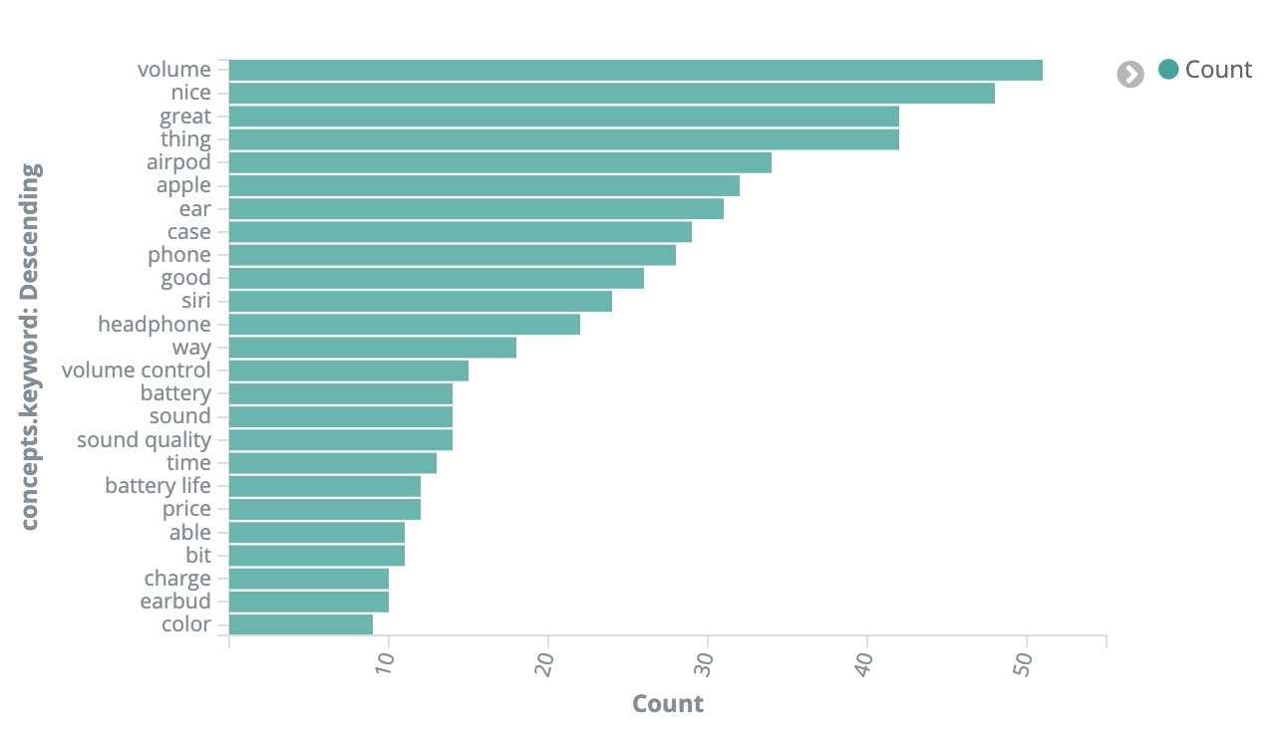
Why is aggregation important?
Notes:
This is what the concepts look like for air buds on their own. It is dominated by irrelevant terms and similar ideas – “nice”/”great” are split out into different bars. (battery/battery life; volume/volume control).

Slide 28
Aggregate Concepts
Create a synonym dictionary
Select the most representative synonym per set
How?

Slide 29
colors
headset
...
long life
echo
assistant
pink
green
silver
...
ae2 headset
headset go
wireless headsets
...
bateery life
batery life
long battery life
...
alexa
echo / alexa
siri assistant
voice assistant
...
...
...
...
Synonym Dictionary
Notes:
Each colored column is its own set of synonyms – step 1 is creating these columns
The topmost one is the chosen representative – step 2 is creating this row
Can be up to 9 synonyms

Slide 30



Aggregate Concepts
Preprocess concepts
Encode concepts
Compare concepts and create dictionary
Choose the best synonym per set
The Overview
Notes:
Important to have ALL concepts, not just one at a time
First preprocess to generally clean them up because concepts are verbatim
Then vectorize so they can be compared
For each concept:
Find the most similar concepts to it
Add an entry to the dictionary with all those concepts
Remove all those concepts from the full set

Slide 31
Aggregate Concepts
Apple
apple
delighted
delights
I wish
please
Sound quality
sound quality
apple
apple
delighted
delights
i wish
please
sound quality
sound quality
apple
apple
delighted
delights
i wish
please
sound quality
sound quality
apple
delight
Preprocess concepts
apple
delight
i wish
please
sound quality
sound quality
apple
apple
delight
delight
sound quality
sound quality
apple
delight
sound quality
apple
delight
sound quality
Notes:
This is the preprocessing step. It involves many things (lemmatization, stopwords, removing duplicates).
Lowercase → spacing/punctuation → lemmatization → remove stopwords → remove duplicates
went from 8 to 3

Slide 32
Aggregate Concepts
Lemmatization
Stopwords
Normalize and Remove Duplicates
Notes:
Generally include articles like “the”, “a”, negations like “not”
Here, removed “-PRON-” left over from lemmatization
Removed wishlist-query words and phrases, such as “I wish” and “Please add”

Slide 33
Aggregate Concepts
Lemmatization
Stopwords
Sets
Normalize and Remove Duplicates
Notes:
Kept track of all the concepts in both a list (for order) and a set (to eliminate duplicates)

Slide 34
Aggregate Concepts
What is encoding?
Encode all concepts
Notes:
Convert to vectors based on word cooccurrence probabilities: ‘queen’ and ‘king’ are likely to appear in the same context, as are ‘man’ and ‘woman’. But ‘queen’ is closer to ‘woman’ and ‘king’ is closer to ‘man’.
two words a and b are similar if P(w|a)=P(w|b) for every word w.

Slide 35
Aggregate Concepts
What is encoding?
First attempt using BERT model
Encode all concepts
Notes:
BERT is state-of-the-art by Google
Was giving quite poor results, as a result of being trained on Wikipedia
Bert as a service base model
Significant overhead involved in training on our own dataset, so…

Slide 36
Aggregate Concepts
What is encoding?
First attempt using BERT model
Settled on using fasttext model
Encode all concepts
Notes:
Train quickly directly on reviews dataset
Tried both skipgram and bag of words models
from Facebook: word representation model

Slide 37
Aggregate Concepts
Score word pairs based on normalized dot product
Adjust the score
Determine a score threshold based on number of words
Find first k synonyms that exceed a score threshold
Add these synonyms as a list to the dictionary
Remove these synonyms from the concept set
Synonym Dictionary Creation
Notes:
k is a tunable parameter for the maximum number of synonyms, after which results may get murkier

Slide 38
pink
4.0
green
3.6
4.2
5.3
headset
colors
Notes:
(Note: not actual vector representation)
Score word pairs based on normalized dot product (directionality)
Adjust the score based on item crossed with itself (Normalize output for a common threshold) - magnitude
Determine a score threshold based on number of words
Find first k synonyms that exceed a score threshold
Add these synonyms as a list to the dictionary
Remove these synonyms from the concept set

Slide 39
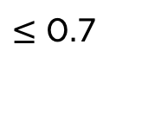
pink
0.4
green
0.4
0.0
0.6
0.6
1.7
headset
colors
$≤$ 0.7
Notes:
Score word pairs based on normalized dot product
Adjust the score based on item crossed with itself (Normalize output for a common threshold) - magnitude
Determine a score threshold based on number of words
Find first k synonyms that exceed a score threshold
Add these synonyms as a list to the dictionary
Remove these synonyms from the concept set

Slide 40
pink
green
colors
Notes:
Score word pairs based on normalized dot product
Adjust the score based on item crossed with itself
Determine a score threshold based on number of words
Find first k synonyms that exceed a score threshold
Add these synonyms as a list to the dictionary
Remove these synonyms from the concept set

Slide 41
colors
headset
...
long life
echo
assistant
pink
green
silver
...
ae2 headset
headset go
wireless headsets
...
bateery life
batery life
long battery life
...
alexa
echo / alexa
siri assistant
voice assistant
...
...
...
...
Synonym Dictionary
Notes:
Best option still a black box

Slide 42
Aggregate Concepts
Tested various approaches:
APPROACH 1.0: Encode against each other and select top with normalized dot product
APPROACH 1.1: Encode against each other and select top using Jaccard distance
APPROACH 1.2: Encode against each other and select top using Levenshtein distance
APPROACH 2: Select the shortest one
APPROACH 3: Choose most common/longest ngram
Choosing the Best Synonym
Notes:
Given a set of synonyms, how to choose the best one. None on their own very effective because there are different reasons synonyms were grouped.
1.0. distance measure used in previous steps. Uses word encodings, which contain info about related words (eg. Spotify/Pandora)
1.1/2. string distance measures. Good for similar words/phrases (eg. Misspellings)
J: |X∩Y| / |X∪Y|
L: minimum number of single-character edits (i.e. insertions, deletions or substitutions) required to change one word into the other.
Why not use other distance measures in OG algorithm? Because they require more context
2. Self explanatory. Good for simplicity.
3. Ngram = sequence of characters. Uses tunable parameters which are difficult to set universally. Can get multiple words. Isn’t restricted to the concepts in the dataset. (eg. “1 headphone”, “3 headphone”, “ie headphone”, “bt headphone” → “headphone”)
Each has its strengths/weaknesses – ideally (with more time) would work on a way of combining approaches

Slide 43
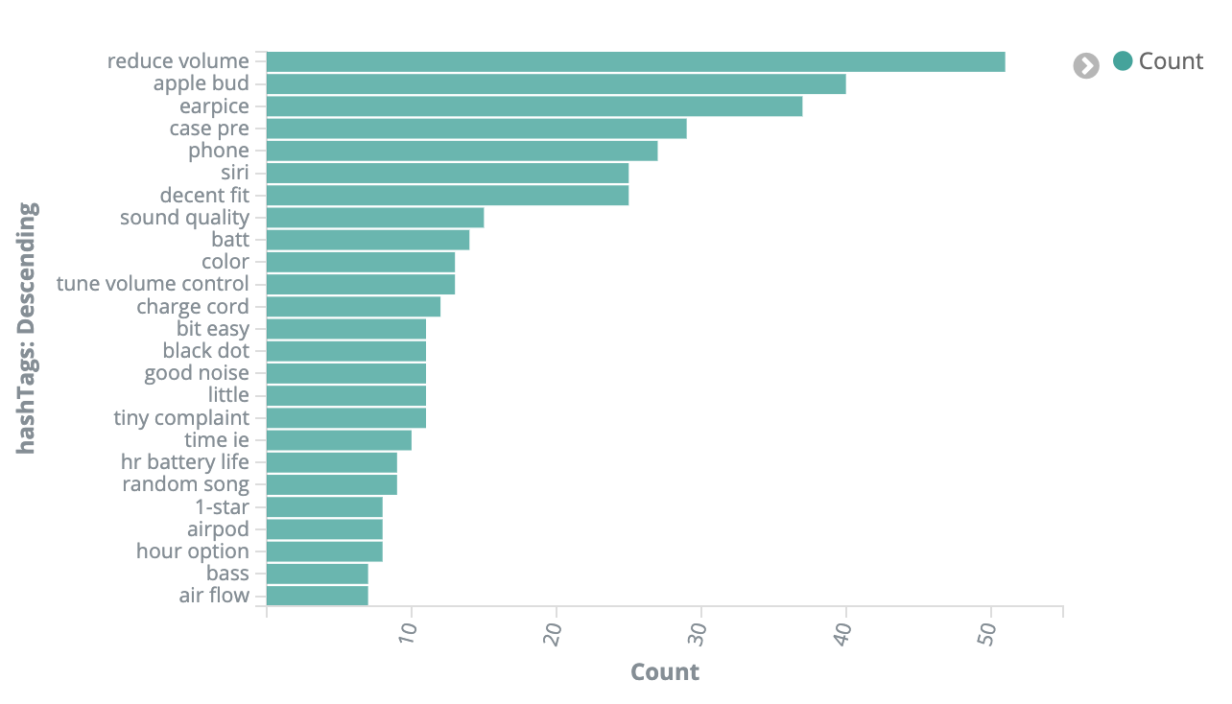
Notes:
Topic aggregation for airpods – surfaces the same controls that Russel and Ravi found manually – volume control, earpiece fit
Top concerns: volume control/earpiece fit, then sound quality, then battery life, then color
An analyst can further parse the data

Slide 44
Displaying Fields

Slide 45
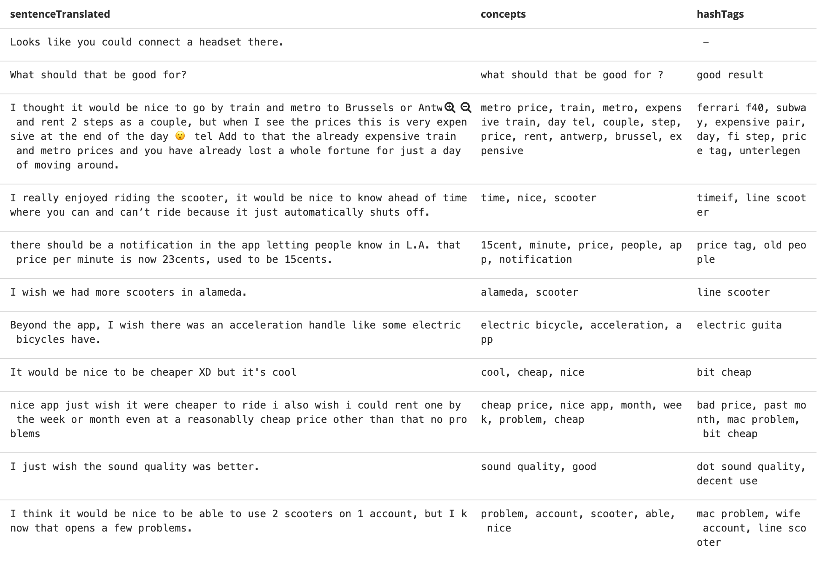
“I wish it came in pink.”
pink
colors
“It would be great if you had green too.”
green
colors

Slide 46
Display Fields
Several nested layers of data
Difficult to store in a format that can be interpreted by Kibana visualization services
Solved problem by creating secondary indices
Elasticsearch Indices
Notes:
Complicated data; not easily stored in elasticsearch
Need multiple wishlist sentences assigned to individual reviews (or other source), need concepts and hashtags assigned to sentences
Problem originally arose with entity sentiment service linking sentiment scores with their entity
Investigated solutions in ES – the primary solution (nested fields) for the problem does not support visualization
Eventually landed on a solution I proposed based on research: start a secondary index to track at a more fine-grained level
(Previously separate indices were being used only for different types of data, e.g. reviews vs. surveys)

Slide 47
What I would improve
Further Aggregation
Best Synonyms Selection
Rule-Based Categorization
Notes:
Several rounds of aggregation to combine similar sets of synonyms
Combine methods to play to their strengths and weaknesses – have a few other ideas in mind
Categorization model is moving toward ML approaches. Would like to be able to apply that here as well, as it is such a broad category that it likely cannot be entirely covered by rules

Slide 48
Wishlist Service
Source:
Notes:
Augment data by identifying items that customers want to see.

Slide 49
What I learned
Technologies: Elasticsearch/Kibana, Python, Jupyter Notebook, NLP libraries
Skills: developing and refining an algorithm, communicating with stakeholders to suit their needs, working as part of an Agile team
About myself: I can survive two months back at home with my parents and brother!
Notes:
Really loved working at Bose. Have had not-great internships in the past and this was totally different.

Slide 50
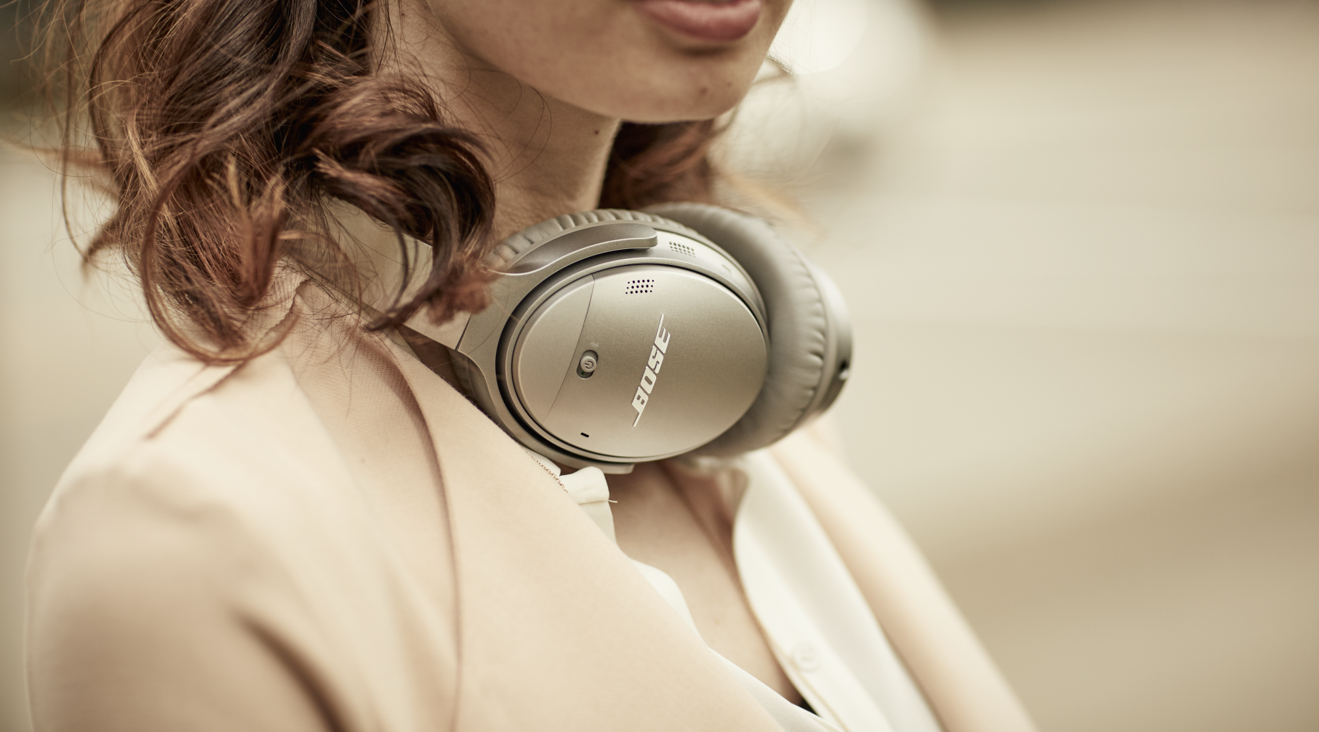
Questions?
Notes:
x

Slide 51
